Slide 1

Credit card approval prediction dataset
Presented By: Hadwala Akhil

Slide 2
About me
I’m Hadwala Akhil, a graduate with a Bachelor of Technology in Electrical and Electronics Engineering from Vidya Jyoti Institute of Technology, Hyderabad
Why Data Science?
• Interest in data-driven decision making
• Driven by Exciting Career opportunities
• Problem-solving using data
• It’s a field, where we can get to know about different domains by working on their data

Slide 3
Understanding Credit card approval prediction dataset
To determine credit card eligibility of applicants based on their financial and credit history data.
Credit card issuing companies need to ensure that applicants are financially reliable before approving a credit card. A poor approval decision may result in defaults, which lead to financial losses. Therefore, analyzing customer application information (demographics, income, family details) along with their credit repayment history is essential to decide whether a client is eligible or not eligible for a credit card.
The dataset contains 36,457 rows and 21 columns. Out of which there are 12 Numerical and 9 Categorical columns
Now let’s understand every column one by one

Slide 4
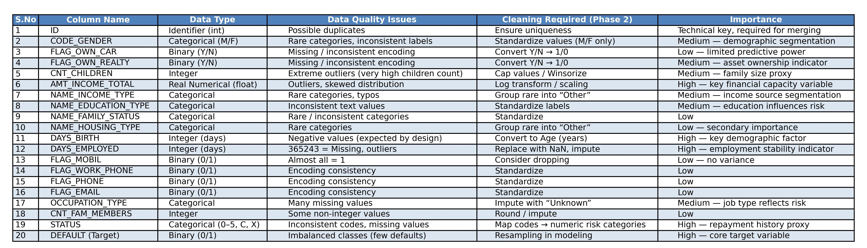
Understanding columns

Slide 5
Handling Outliers
An outlier is a value in your data that is very different from most of the others. Outliers can cause problems if we ignore them, they can mess up your statistics and skew visualizations
Outliers are different or extreme values that can that can shrink or squeeze your plot or graph
Most of the data is distributed or spread around the mean or median but due to that one extreme value we are unable to visualize the plot properly
In our dataset we have outliers. We have successfully handled outliers using IQR method which is one of the best method
In the next slide, we have plotted box plot using amount income total variable with and without outliers

Slide 6
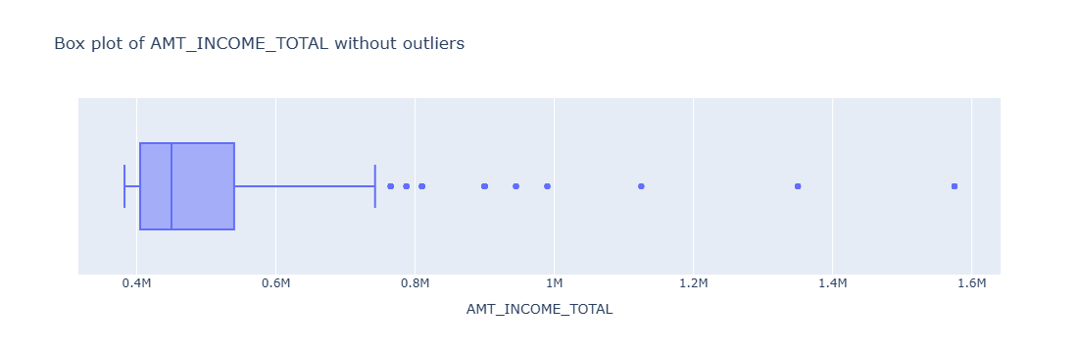
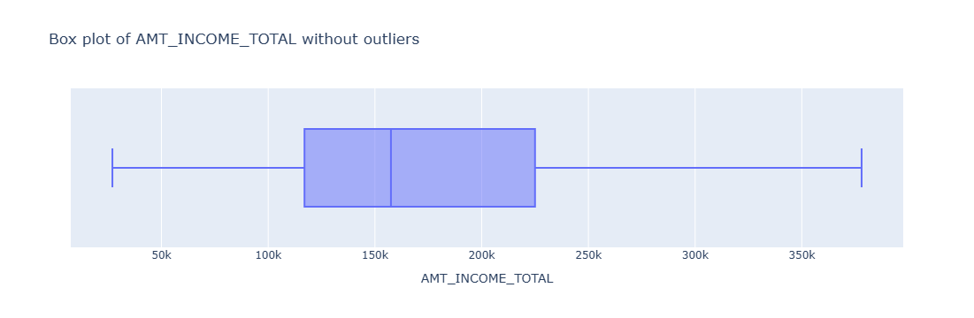

Slide 7
Handling Missing data
Handling Missing data
In our dataset, we have 31% missing data in one of the column called occupation type
If you fill everything with the mode (most frequent occupation), you’ll artificially inflate that occupation by ~31%, which will distort your analysis/model.
If you drop the column, you lose a potentially useful feature.
If you create a new category "Unknown", you keep the data and also preserve the information that occupation wasn’t reported.
Handling duplicate values
In my dataset there are no duplicate values, still I have checked them using dataframe.duplicated().sum() which will give column wise duplicate values sum available in the data frame
If there are 0 values for every column, then there are no duplicates available in the dataframe
If your data Frame has no duplicates, your data will be clean, accurate, and trustworthy data, faster performance, better analytics and modeling results, Easier debugging and maintenance.

Slide 8
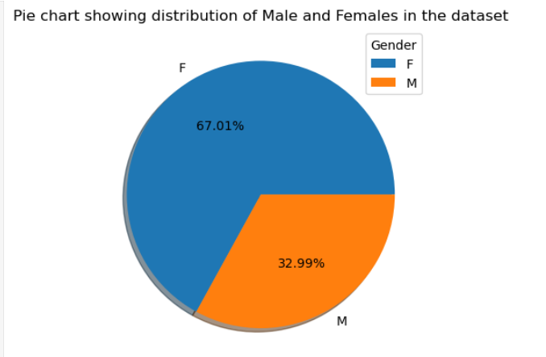
Univariate Analysis
Univariate analysis is nothing but performing analysis on a single variable or column
1. Pie chart showing percentage of Male and Female customers present in the dataset

Slide 9
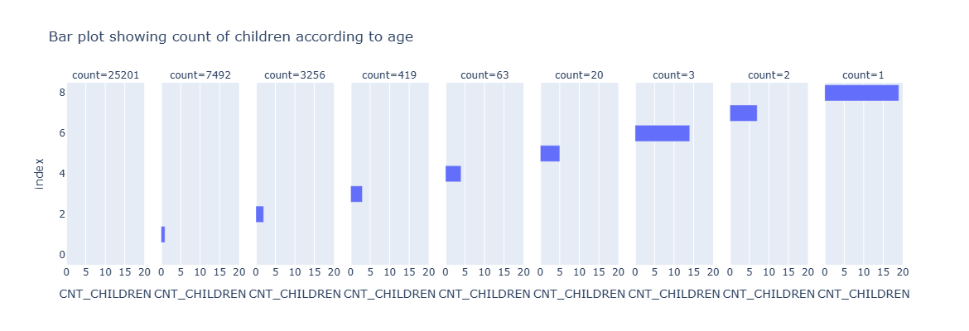
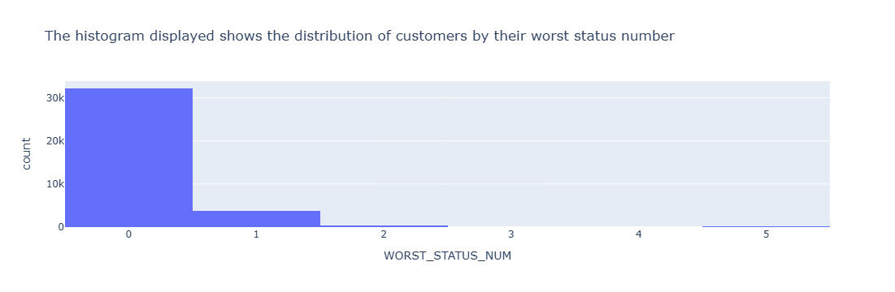
2. Bar plot and histogram plot showing Univariate Numerical Analysis

Slide 10
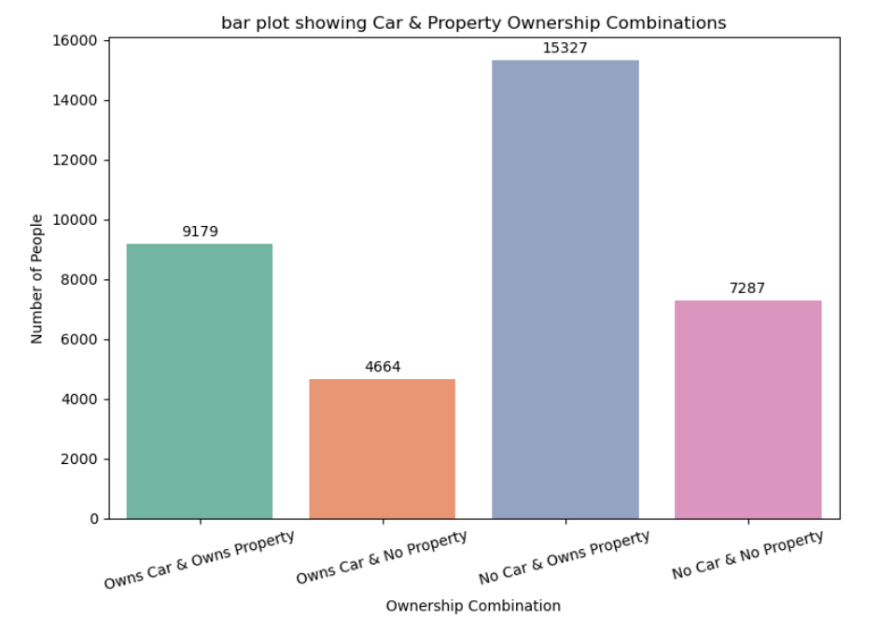
Bivariate Analysis
Bivariate analysis studies the relationship between two variables to identify trends, associations, or dependencies.
1. categorical vs categorical :
Car & Property Ownership Combinations vs Number of People

Slide 11
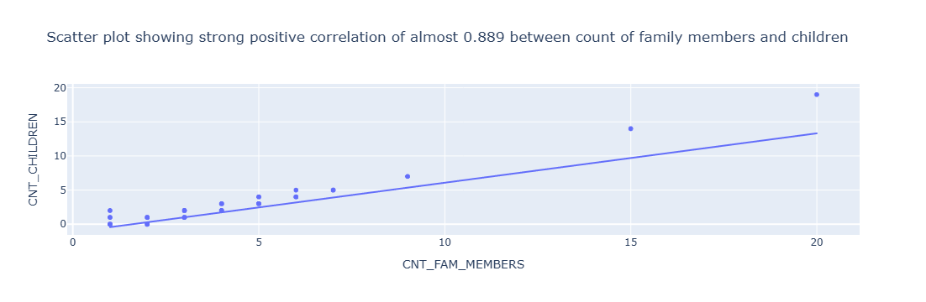
2. numerical vs numerical

Slide 12
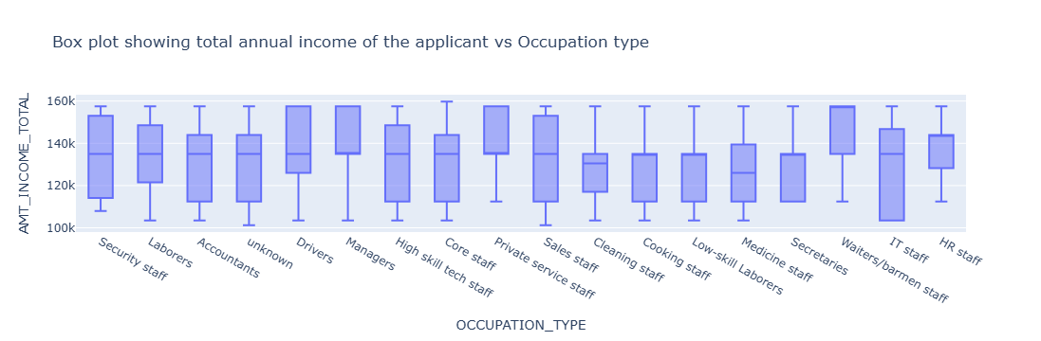
3. Categorical vs Numerical

Slide 13
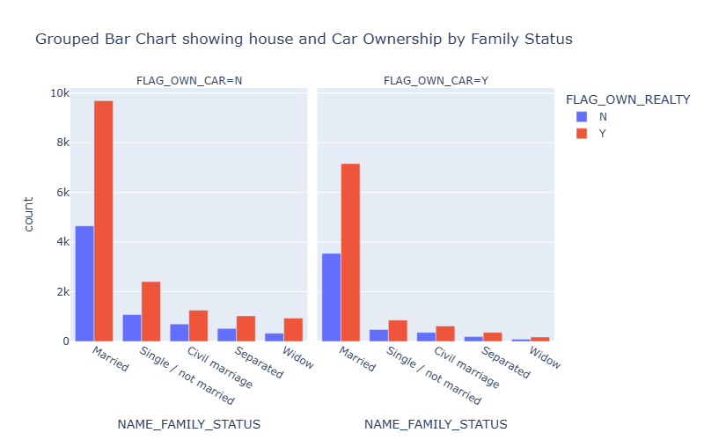
Multivariate Analysis
Multi-variate Analysis means using more than two variables for analysis . The below graph is generated using three categorical variables and one numerical variable – family status, customer own car, customer own house, and count of customers

Slide 14
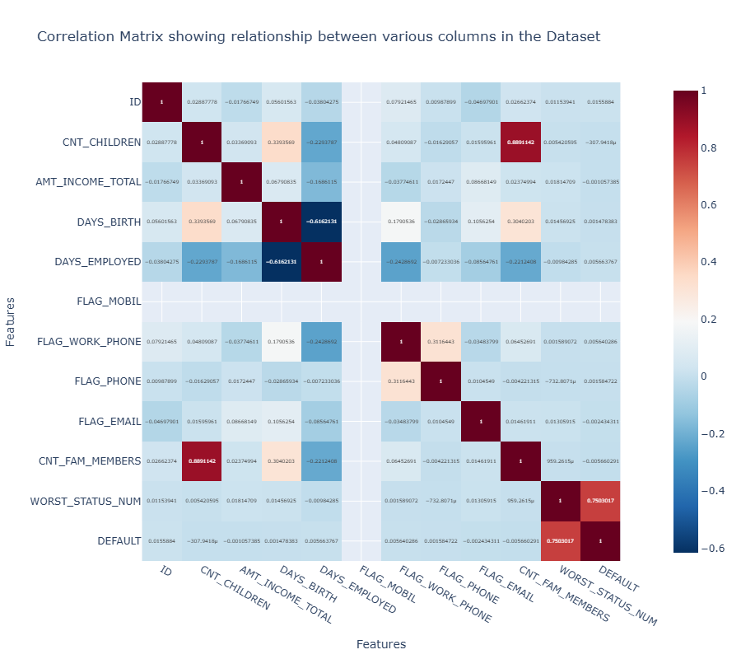
Correlation matrix showing relation of all numerical variables with another numerical variable

Slide 15
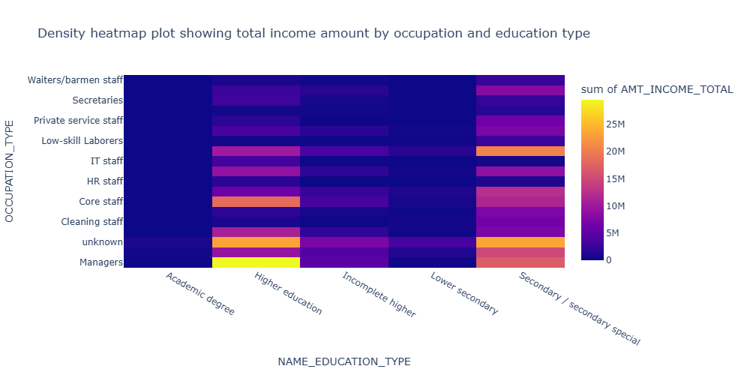
Density heatmap is utilizing three categorical variables – Annual Income, Education type, and Occupation type

Slide 16
Insights
Most applicants are from working-age groups with stable housing.
Income is skewed, with many in low–mid ranges.
Credit history (STATUS) is the strongest factor in approval.
Default cases are linked to irregular/overdue payments.
Most applicants have long employment history, showing job stability.
Applicants with consistent repayment records are highly likely to be approved.
Income and occupation still play an important role, but less than repayment behavior.
Employment length shows that many applicants have stable jobs.
Repayment status (STATUS) reveals clear separation between eligible and not-eligible applicants.
Customers with long and consistent repayment history are more likely to be approved.

Slide 17
Conclusion
Repayment behavior is the strongest determinant of credit card approval.
Demographics help but are less important than credit behavior.
Reliable repayment behavior reduces default risk significantly.
Financial institutions can safely rely more on credit history than demographics.
Proper data preprocessing (cleaning, balancing) is crucial for good model performance.

Slide 18
Future scope
Incorporate additional variables like spending patterns, loan history, and external credit bureau scores.
Apply deep learning models (e.g., LSTMs for sequential credit history data).
Build a real-time credit approval system integrating APIs with banks
Deploy models on cloud-based platforms for handling large-scale applications.
Continuously retrain with new data to adapt to changing applicant behaviors.
Integrate fairness checks to avoid gender or income-based bias.
Apply the same approach to other financial products (loans, mortgages).

Slide 19

THANK YOU

